Slide 1

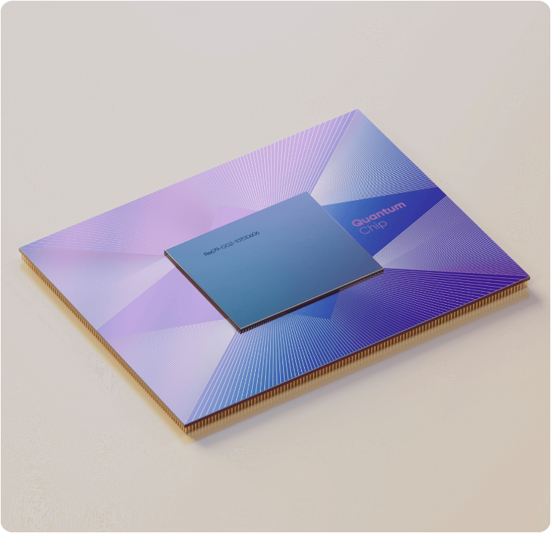

SyncBoard -Real-Time Collaborative Workspace for Teams
Real-Time Collaboration Platform focused on transparency, accountability, and efficient team workflows.

Slide 2
Team Details
Title: Team Details
Project Name: SyncBoard
Team Member: Harshita Bisht
Role: Full Stack Developer
Responsibilities:
Frontend Development
Backend Development
Database Design
Authentication & Authorization
Real-Time Collaboration Implementation

Slide 3
Problem Statement Title: Problem Statement Content: ✅ Teams struggle to track tasks across multiple communication channels. ✅ Lack of visibility causes missed deadlines and reduced accountability. ✅ Existing solutions can be complex for small teams and student projects. ✅ Real-time collaboration and transparent activity tracking are often limited.

Slide 4




Project Introduction
Key Design Principles
Simplicity usability and real time collaboration ensure seamless user experience and effective team coordination .
Target User
Students
Startup Teams
Development Teams
Project Managers
Core Concept
SyncBoard is a real-time collaboration platform that enables teams to organize work, track progress, and improve accountability through transparent task management.
Primary Value Proposition
Real-time collaboration
Transparent workflows
Better task visibility
Improved accountability

Slide 5


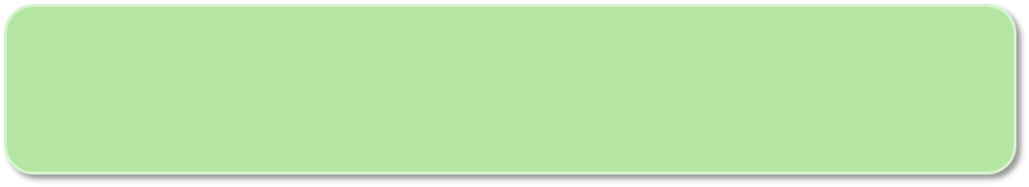



Project Objectives
Build a Scalable Collaboration Platform
Create robust , scalable task management platform delivering core functionality for enterprise-level performance requirement.
01
Enable Real Time Collaboration
Implement simultaneous multi user feature with live update enabling seamless team coordination and enhanced productivity.
02
User Friendly Interface
Design clean intuitive UI with minimal learning curve ensuring rapid adoption across divers user skill levels.
03
Secure Data Management
Establish secure authentication mechanisms and comprehensive data protection protocol safeguarding sensitive information.
04

Slide 6
Key Feature & Capabilities
✅ Real-Time Collaboration
✅ Activity History Logs
✅ Role-Based Access Control
✅ Team Member Invitations

Slide 7

02 Technical Architecture
& Design

Slide 8





Technology Stack Overview
Frontend Framework
React.js enables dynamic responsive user interface with excellent component reusability.
Backend Framework
Node.js with express.js provide light weight scalable API development with non blocking architecture .
Database System
MongoDB offers flexible document- based data storage with horizontal scalability and schema less design.
Authentication Protocol
JWT implement stateless , secure user authentication without server-side storage requirement.
Development Tool
Postman facilitates API testing while GitHub enables version control and seamless team collaboration throughout lifecycle.
Socket
Used socket.io for the real time collaboration to increase the efficiency of the user.

Slide 9
System & Architecture
Frontend Layer
API Communication
Backend Layer
Optional Enhancement
Database Layer
Node.js with express.js provide light weight scalable API development with non blocking architecture .
React.js enables dynamic responsive user interface with excellent component reusability
RESTFUL API enables seamless data exchange facilitating smooth interaction between backend and frontend
MongoDB stores user data ,boards , list , card with proper indexing for optional performance.
WebSockets provide instant synchronization between connected users

Slide 10
Database Schema Design
Collection | Key Field | Purpose
History | boarsId, userId, entityType, entityId, details | Tracks user actions and activity logs
User | name , email , password , profile | Authentication and user management
Board | Title , owner , member , created data | Workspace organization
List | Title , board Id , order | Task categorization
Card | Title , description , list Id , assignment , due-date | Task details and tracking

Slide 11
03 Workflow
& Implementation

Slide 12
User Journey & Workflow
✅ Authentication
✅ Board Creation
✅ List Creation
✅ Task Creation
✅ Task Updates
✅ Task Completion

Slide 13
Implement Challenges
Drag-drop Complexity
Implementing smooth responsive drag-drop with state synchronization across component seamlessly.
Database Relationship
Managing complex object relationship and maintaining data consistency during all operation.
Secure Authentication
Implementing robust JWT token management , refresh token logic and password hashing protocol .
Scalable API Design
Designing efficient backend API handling concurrent user while maintaining performance at scale .
Real-Time Synchronization
Managing multiple users editing the same board simultaneously.

Slide 14
Key Feature
✅ Real-Time Collaboration
Instant updates using WebSockets.
✅ Activity History Logs
Track every important action.
✅ Role-Based Permissions
Controlled access for teams.
✅ Team Transparency
Everyone sees project progress.

Slide 15
Current Development Progress
Completed
✅ Authentication
✅ Boards
✅ Lists
✅ Tasks
✅ Drag & Drop
✅ Permissions
✅ Real-Time Updates
✅ Activity Logs
In Progress
🔄 Email Invitations
🔄 Deployment

Slide 16
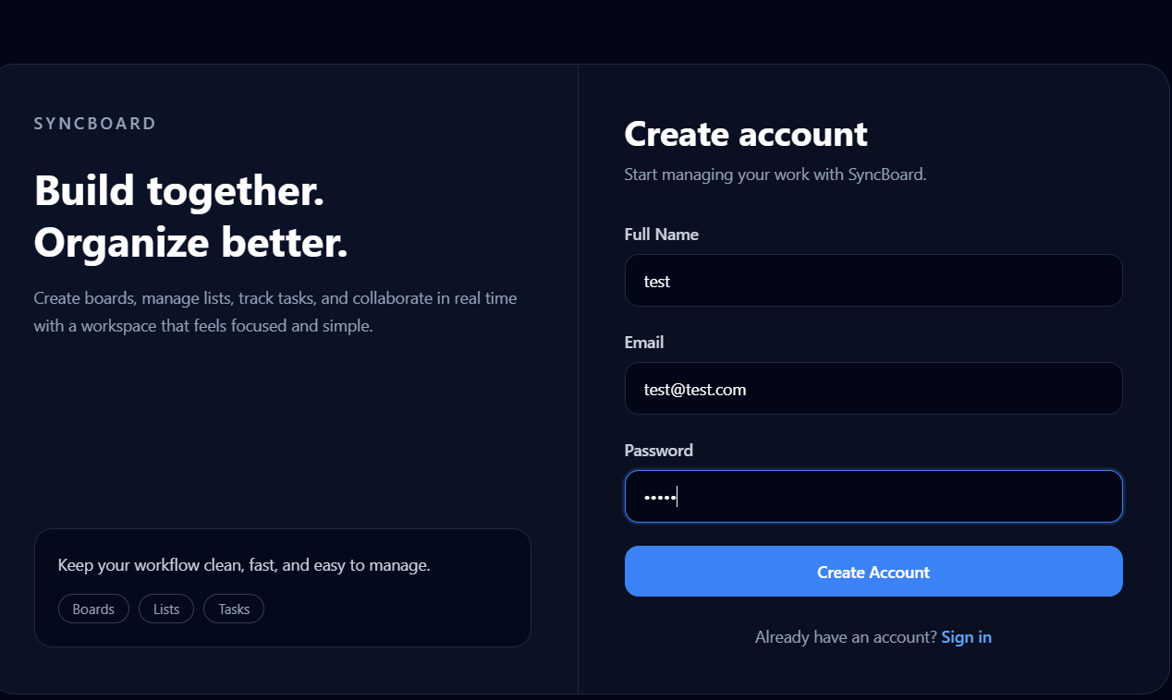
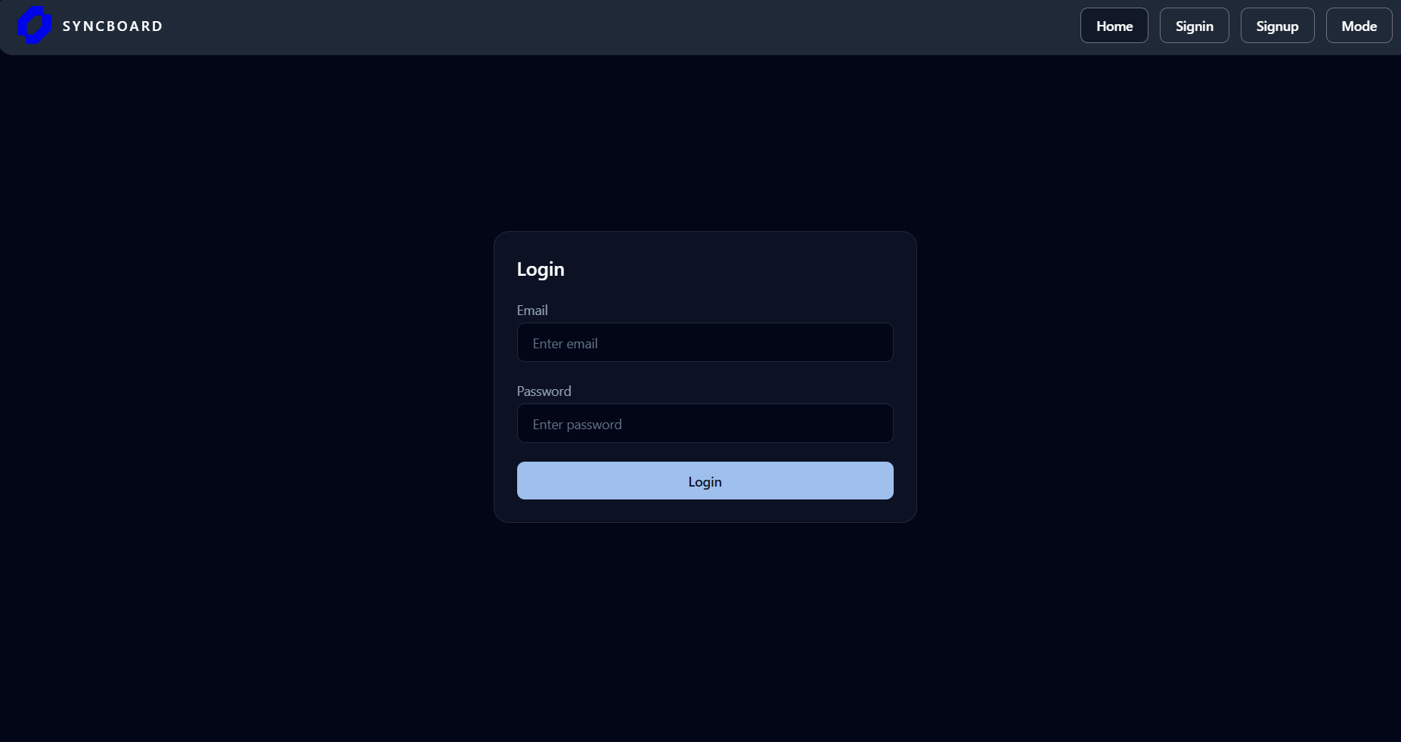
Register
Login

Slide 17
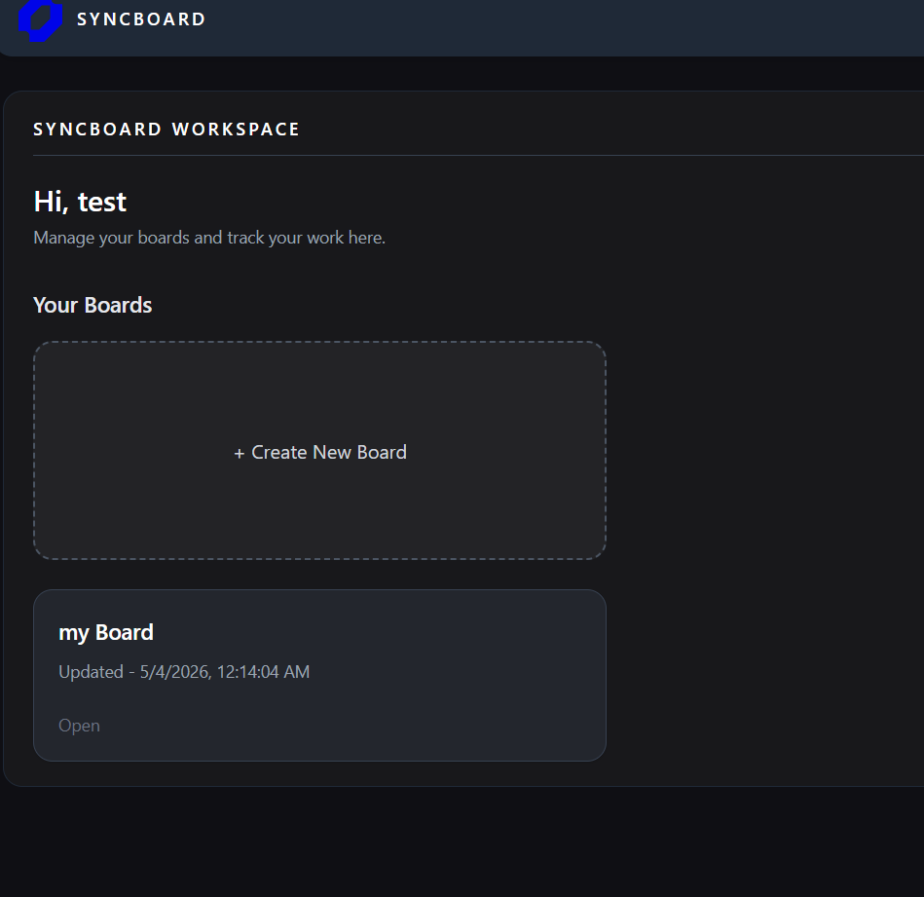
Dashboard

Slide 18
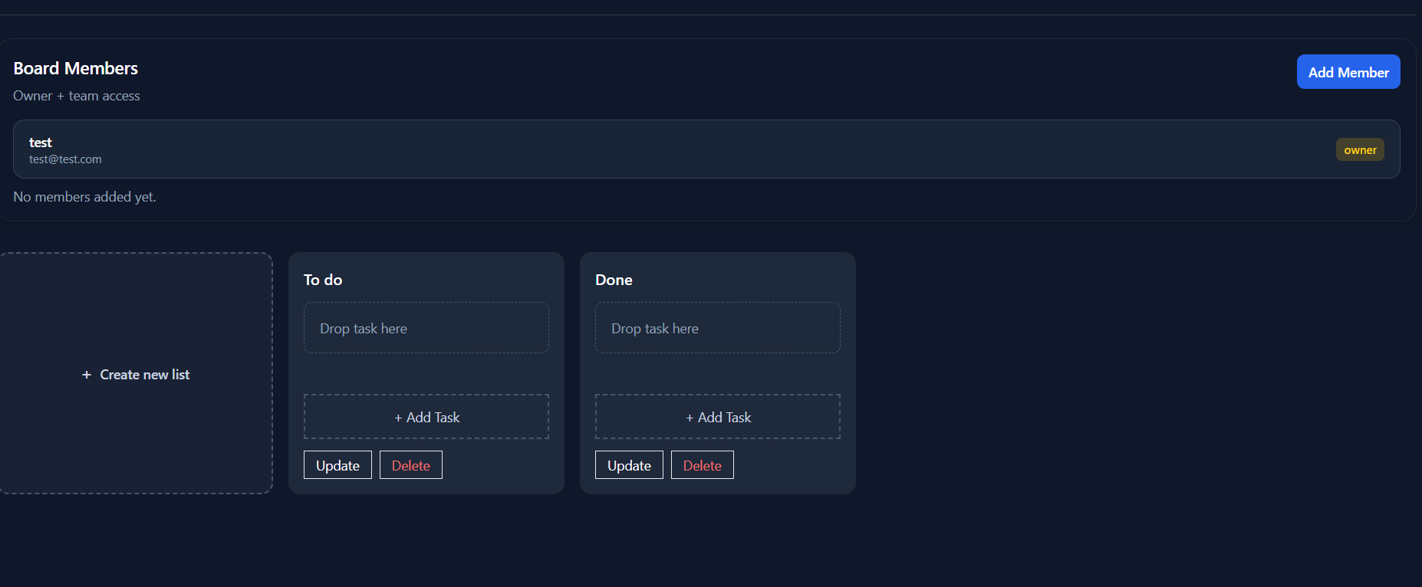
Board View

Slide 19
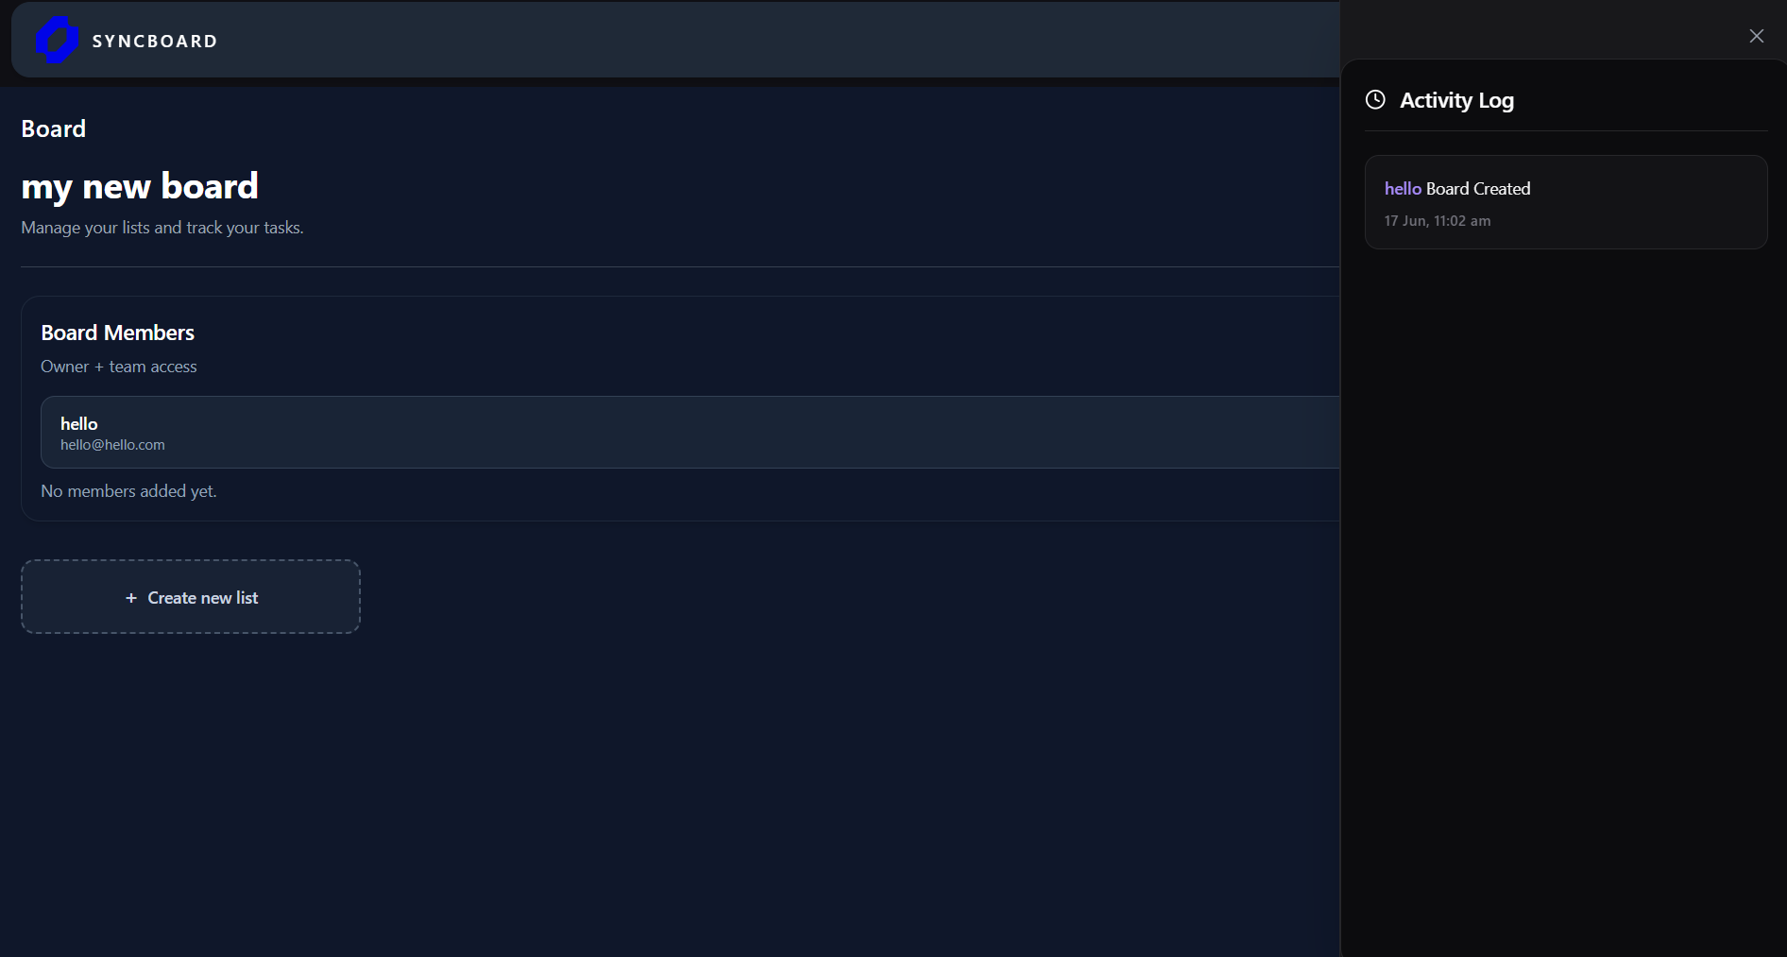
Activity Log

Slide 20
Future Scope
✅ AI Task Recommendations
✅ Team Analytics
✅ Calendar Integration
✅ Mobile App
✅ Smart Notifications

Slide 21
04 Conclusion
& Outcomes

Slide 22
Project Summary & Impact
Productivity Gain
Enhanced task organization , improved progress visibility and significantly strengthened team coordination and operational efficiency .
Deliverable Achievement
SyncBoard improves collaboration by combining real-time communication, transparent activity tracking, and structured workflow management into a single platform.
Technical Scalability
Architected with scalable technology specifically design for relatable enterprise level deployment and future growth.

Slide 23

Thanks

